Slide 1
CH4
Branches
(CH4: BRANCHES)
merge & rebase
Oh, do you really develop everything on main?
That’s a problem.

Slide 2
Branches
(CH4: BRANCHES)
We all know what is a branch but nobody asks why is a branch.
“Branching means you diverge from the main line of development and continue to do work without messing with that main line, to be safe and keep the main safe from you.”

Slide 3
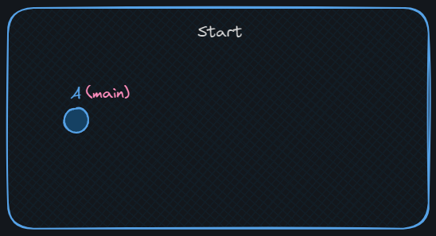
Mission 0
git-branches
(CH4: BRANCHES)
Code your way to succeed
Desired State
Prepare your repo:
Make a new dir called `git-branches`
Make a repo in this dir
Make a README.md with “A” in it and commit with message “A”’

Slide 4
Mission 0
(CH4: BRANCHES)
Desired State

Slide 5
Mission 0
git-branches
(CH4: BRANCHES)
Great Job! Mission 0 status: done
mkdir git-branches
cd git-branches
git init
echo "A" >> README.md
git add .
git commit -m "A"

Slide 6
Creating branches
To create a new branch:
(CH4: BRANCHES)
git branch <branch-name>
To switch to a branch:
git checkout <branch-name>
⚠️ Attention: after you create a branch git doesn’t automatically switch to it

Slide 7
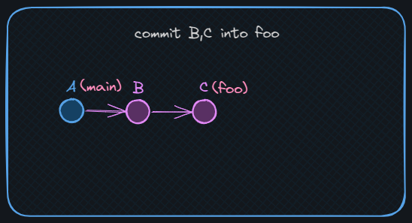
Mission 1
git-branches
(CH4: BRANCHES)
Code your way to succeed
Desired State
Your first branch:
Create a branch “foo” and switch to it.
find foo in .git
Commit “B” and “C” into foo
Note: make the change the same as the commit message

Slide 8
Mission 1
(CH4: BRANCHES)
Desired State

Slide 9
Mission 1
git-branches
(CH4: BRANCHES)
Great Job! Mission 1 status: done
git branch foo
git checkout foo
find .git
# refs/heads/foo
echo "B" >> README.md
git add .
git commit -m "B“
echo "C" >> README.md
git add .
git commit -m "C"

Slide 10
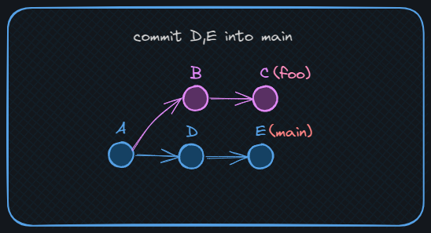
Mission 2
git-branches
(CH4: BRANCHES)
Code your way to succeed
Desired State
Things happen on main, you know:
Switch to main
commit “D” and “E” into a new file second.md
NOTE: make sure to commit in a new file
We don’t want conflicts yet 😉

Slide 11
Mission 2
(CH4: BRANCHES)
Desired State

Slide 12
Mission 2
git-branches
(CH4: BRANCHES)
Great Job! Mission 2 status: done
git checkout main
echo "D" >> second.md
git add .
git commit -m "D"
echo "E" >> second.md
git add .
git commit -m "E“
git log --graph
--oneline --parents

Slide 13
Combining Your Work:
(CH4: BRANCHES)
In git, there are 2 main ways to join branches:
merge
rebase

Slide 14
(CH4: BRANCHES)
merge
“A merge is attempting to combine two histories together that have diverged at some point in the past. There is a common commit point between the two, this is referred to as the best common ancestor”
- The docs

Slide 15
(CH4: BRANCHES)
merge
To merge a branch into the currently checked branch:
git merge <source-name>
Merge has 2 outcomes depending on the state, more on that later.
⚠️ NOTE: the target-branch is the currently checked branch

Slide 16
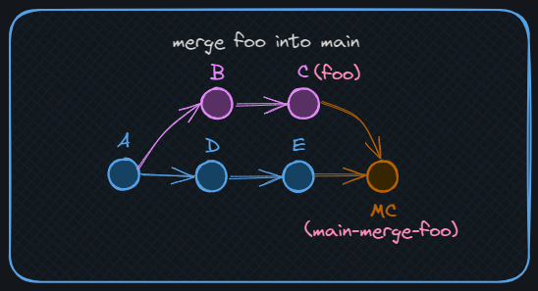
Mission 3
git-branches
(CH4: BRANCHES)
Code your way to succeed
Desired State
Let’s merge:
Create a new branch “main-merge-foo” of main.
Merge foo
Look at the graph

Slide 17
Mission 3
(CH4: BRANCHES)
Desired State

Slide 18
Mission 3
git-branches
(CH4: BRANCHES)
Great Job! Mission 3 status: done
git checkout main
git checkout -b main-merge-foo
git merge foo
git log --graph --oneline --parents

Slide 19
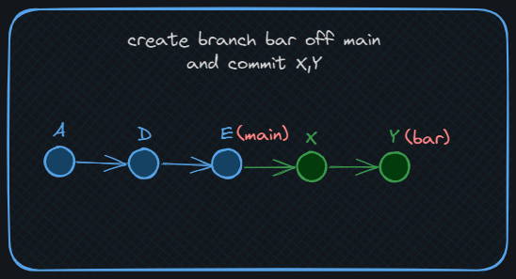
Mission 4
git-branches
(CH4: BRANCHES)
Code your way to succeed
Desired State
Let’s Fast-Forward merge:
Make a new branch “bar” off main.
Commit “X” and “Y” in bar into bar.md
Merge bar into main

Slide 20
Mission 4
(CH4: BRANCHES)
Desired State

Slide 21
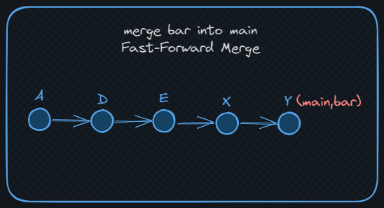
Mission 4
(CH4: BRANCHES)
Desired State

Slide 22
Mission 4
git-branches
(CH4: BRANCHES)
Great Job! Mission 4 status: done
git checkout main
git checkout -b bar
echo "X" >> bar.md
git add .
git commit -m "X“
echo "Y" >> bar.md
git add .
git commit -m "Y“
git checkout main
git merge bar

Slide 23
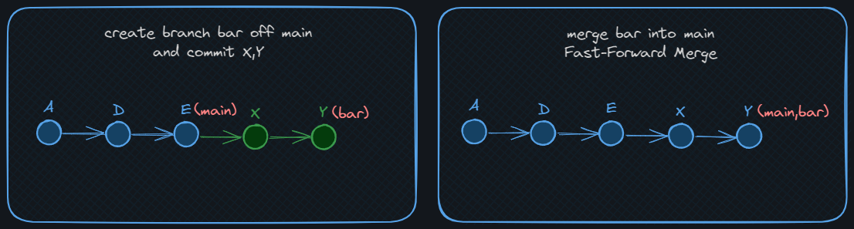
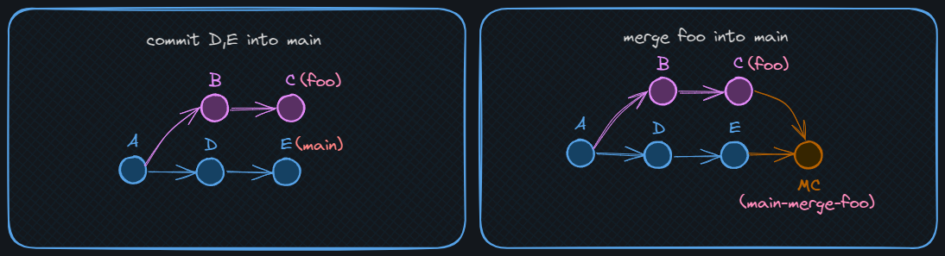
Merge Outcomes:
Fast Forward Merge: just update the pointer/reference (no merge commits)
(CH4: BRANCHES)
Divergence Merge: create a merge commit to combine 2 commits/histories have 2 parents

Slide 24
(CH4: BRANCHES)
rebase
“git-rebase - `Reapply` commits on top of another base tip”
- "the docs"
To rebase a branch:
git rebase <target-branch>
⚠️ NOTE: rebase is often used at your private feature branch, so target-branch is often “main”

Slide 25
(CH4: BRANCHES)
rebase
How rebase works:
checkout the latest commit at `<target-branch>`
replay one commit at a time of the `<source-branch>`
update source branch ref to the latest commit made.
⚠️ NOTE: rebase alters history and creates new commits as commits in git are immutable
Rebase doesn’t create merge-commits.

Slide 26
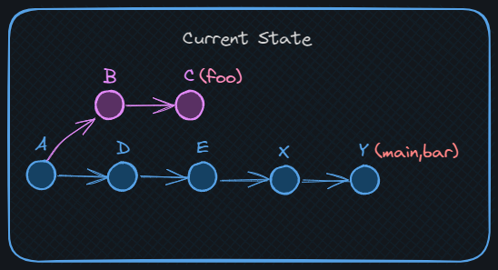
Mission 5: last mission in this chapter
git-branches
(CH4: BRANCHES)
Code your way to succeed
Current State
Rebase Your feature branch:
Checkout foo
Rebase off main

Slide 27
Mission 5
(CH4: BRANCHES)
Current State

Slide 28
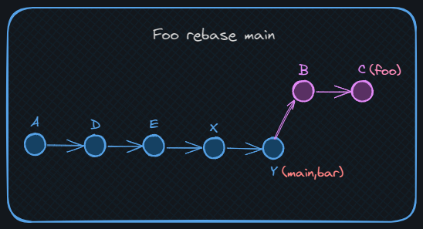
Mission 5
(CH4: BRANCHES)
Desired State

Slide 29
Mission 5: last mission in this chapter
git-branches
(CH4: BRANCHES)
Great Job! Mission 4 status: done
git checkout foo
git rebase main
git log --graph --oneline

Slide 30
Merge VS. Rebase
Merge
Rebase
(CH4: BRANCHES)
doesn't alter history 👍
👍 no annoying merge commits
doesn't require push force👍
👍 linear history which is easier to search
works with private and👍 ‘public branches
👎 alters history
makes annoying merge👎 commits
👎 requires `push force`

Slide 31

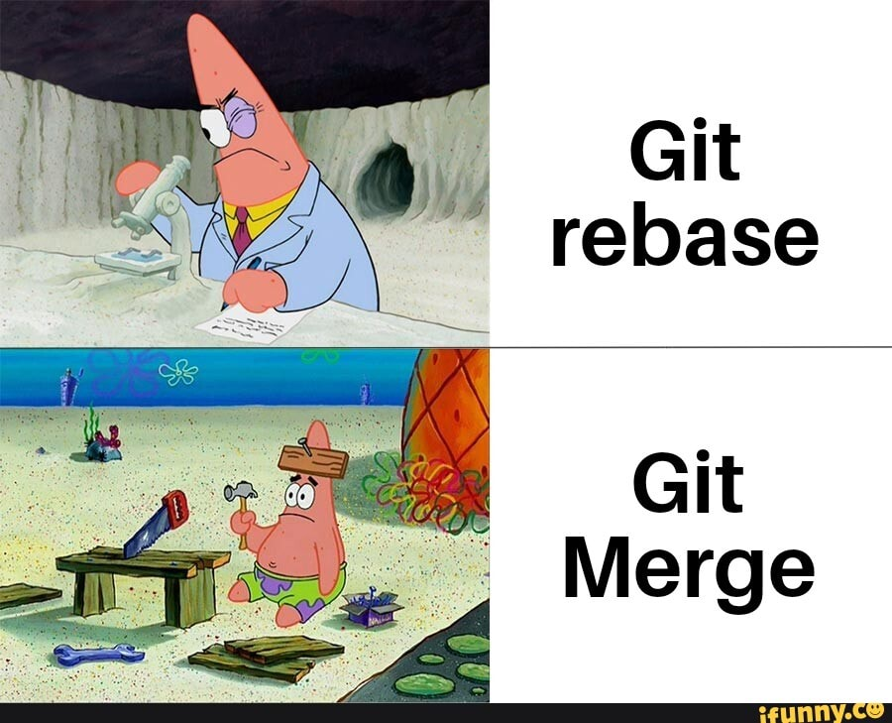
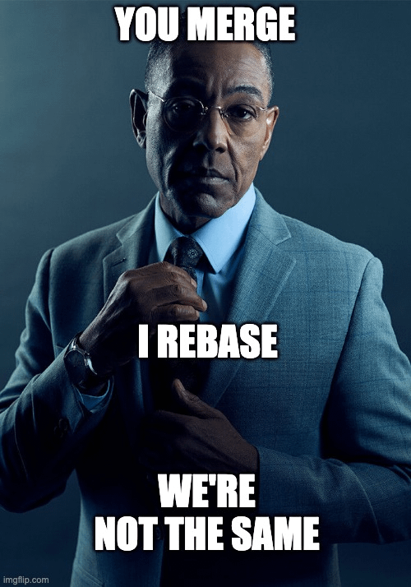
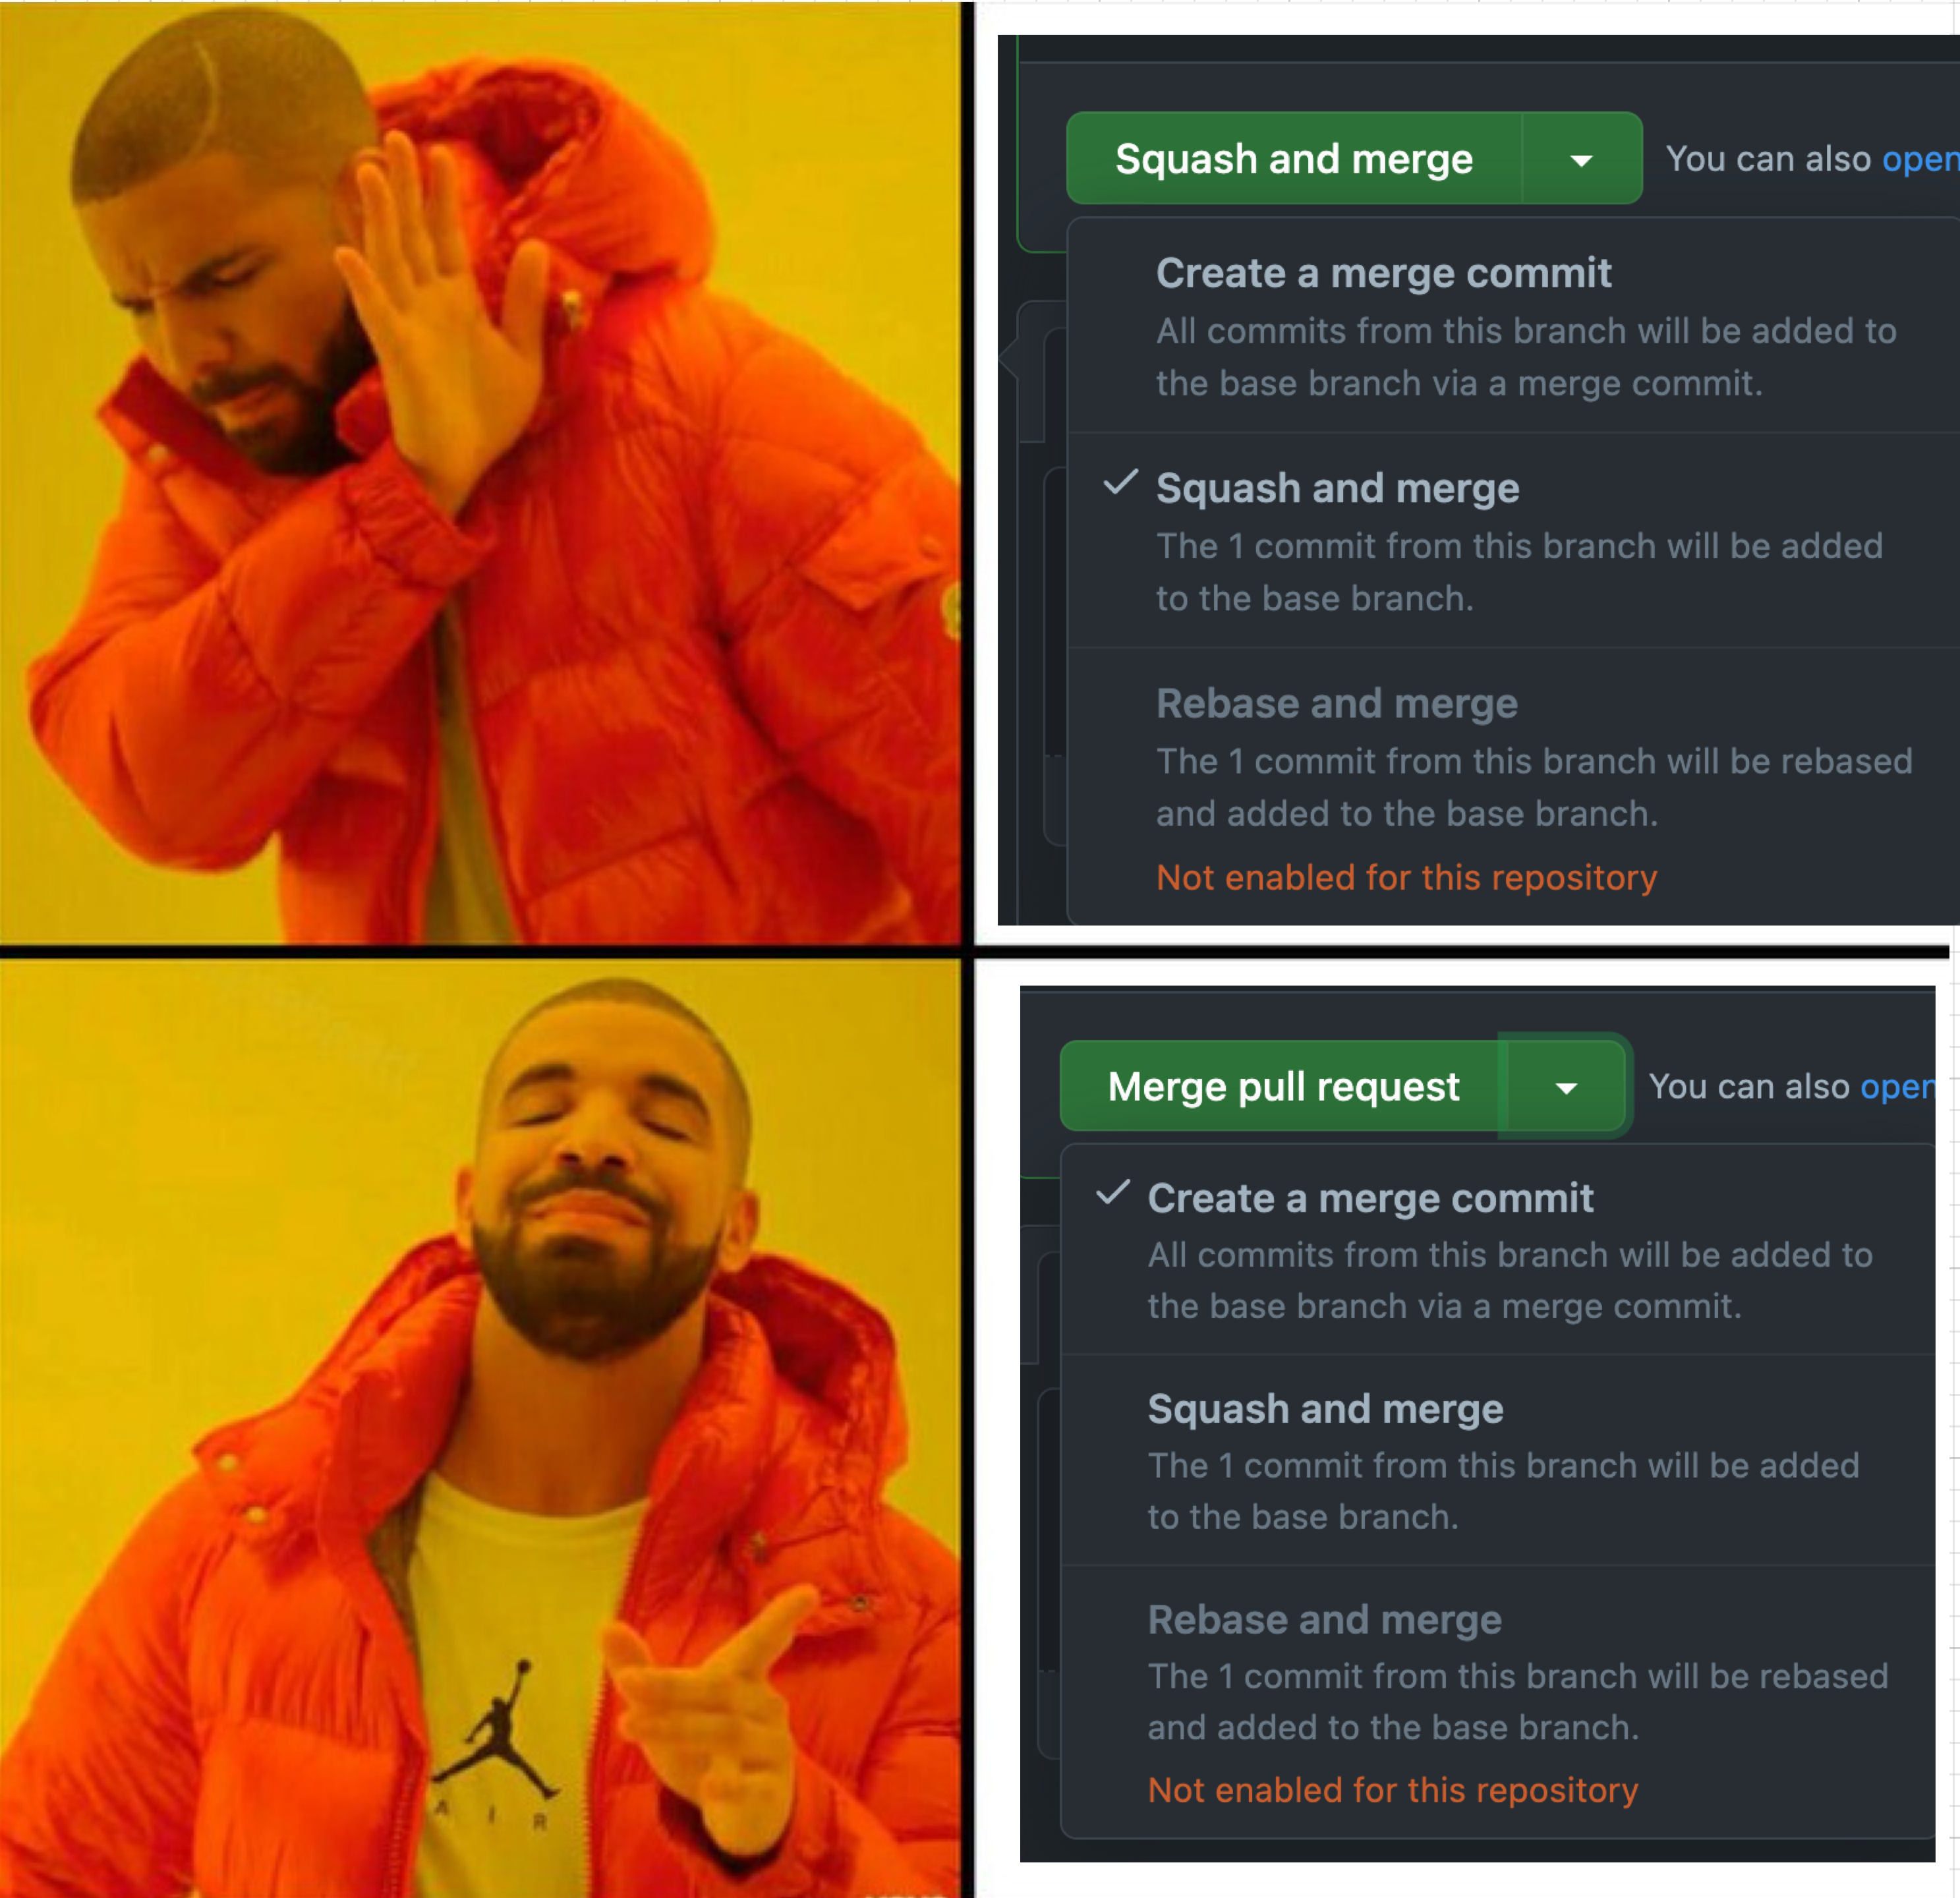
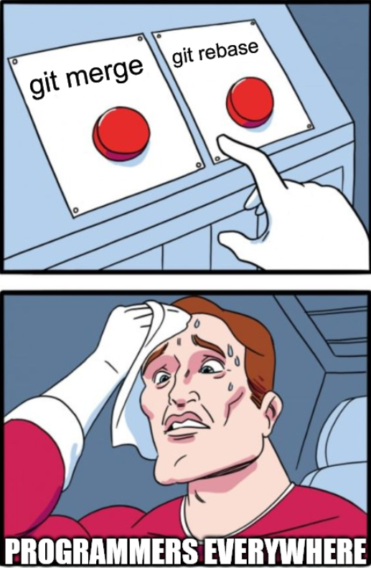
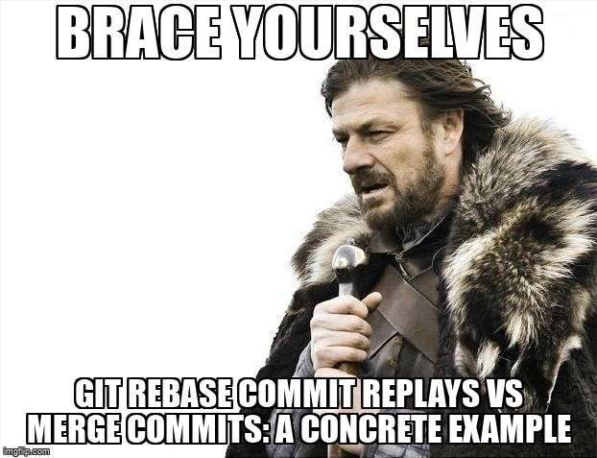
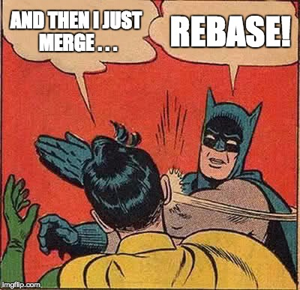
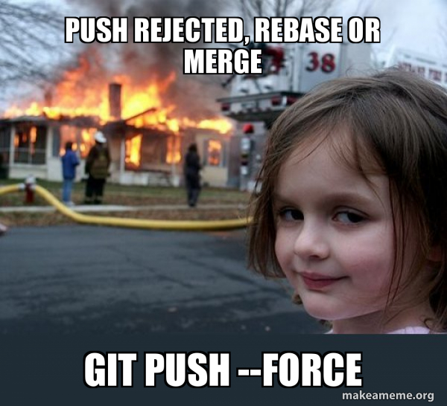

Workflows Wars
(CH4: BRANCHES)

Slide 32
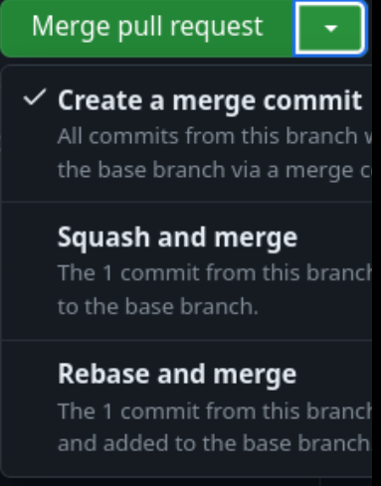
Workflow wars
Merge Workflows (just merge)
(CH4: BRANCHES)
Rebase flow (rebase in private - FF merge in public)
ℹ️ merge back into main
👎 annoying merge commits
ℹ️rebase main into your branch first, then fast forward merge into main
⚠️ NOTE1: people are always so opinionated about which workflow is better, but rebase is diffidently the best 😉
⚠️ NOTE2: the difference between the 2 flows in simple form compiles to which option you choose in GitHub pull request.

